Slide 1


AEM Project Setup
And Component Creation
April 2019

Slide 2


Agenda
01
02
03
Introduction
Templates
Components
04
05
Requirements
Project Setup and structure

Slide 3

Introduction
About AEM

Slide 4

Adobe Experience Manager
AEM
It’s a CMS (Content Management System) that provides website authoring, collaboration and administration tools that help users with little knowledge of web programming languages and markup languages to create and manage website content.
AEM is based on components and templates ad allows Java based development.

Slide 5

Templates

Slide 6
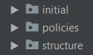
Templates
Are the base for new pages. Templates defines the structure of the resultant page, any initial content and the components that can be used (design properties).
Page templates can be editable, static, content fragments or adaptative.
Notes:
Content fragments: templates para creación de contenido sin la necesidad de crear una página. Contienen texto que se almacena a modo de asset
Y referencias a otros assets tales como imágenes, videos, etc.

Slide 7

Components

Slide 8
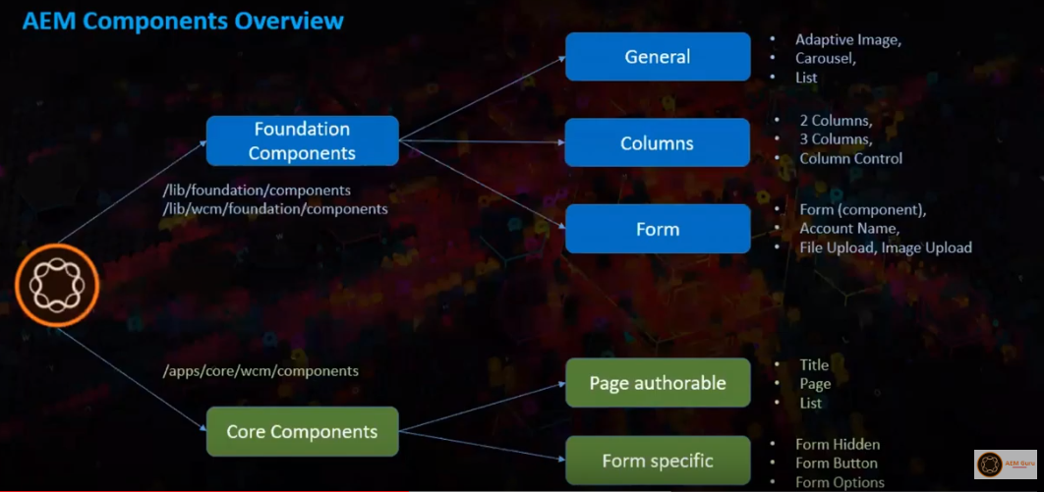
Components
Modular units which perform specific functionalities to present the content on a website. They are reusable.
AEM standard components are defined as cq:Component and have the key elements:
jcr properties
Resources
Scripts
Notes:
JCR properties: variables y subnodos de cq:Component que definen la estructura básica de un componente
Resources: elementos estáticos que son usados por el componente
Scripts: usados para implementar el comportamiento del componente

Slide 9
Components vital
properties
jcr:title Component title. Used as a label when the component is listed in the components browser or sidekick.
cq:editConfig Defines the edit properties of the component and enables the component to appear in the sidekick.
cq:dialog Dialog for the component. Defines the interface allowing the user to configure the componnet and/or edit the content.
jcr:description Description for the component that can be used as mouse-over hint in the sidekick (optional)

Slide 10

Requirements
Java 1.8
Apache Maven (3.39 or newer)
AEM 6.3 or 6.4
IDE
AEM integration tool with IDE (optional)

Slide 11
Project Setup
And Structure

Slide 12
Project Setup
For create a new AEM project use a Maven Archetype like the Maven archetype 15. Just write on a console:
mvn org.apache.maven.plugins:maven-archetype-plugin:2.4:generate \
-DarchetypeGroupId=com.adobe.granite.archetypes \
-DarchetypeArtifactId=aem-project-archetype \
-DarchetypeVersion=15 \
-DarchetypeCatalog=https://repo.adobe.com/nexus/content/groups/public/

Slide 13
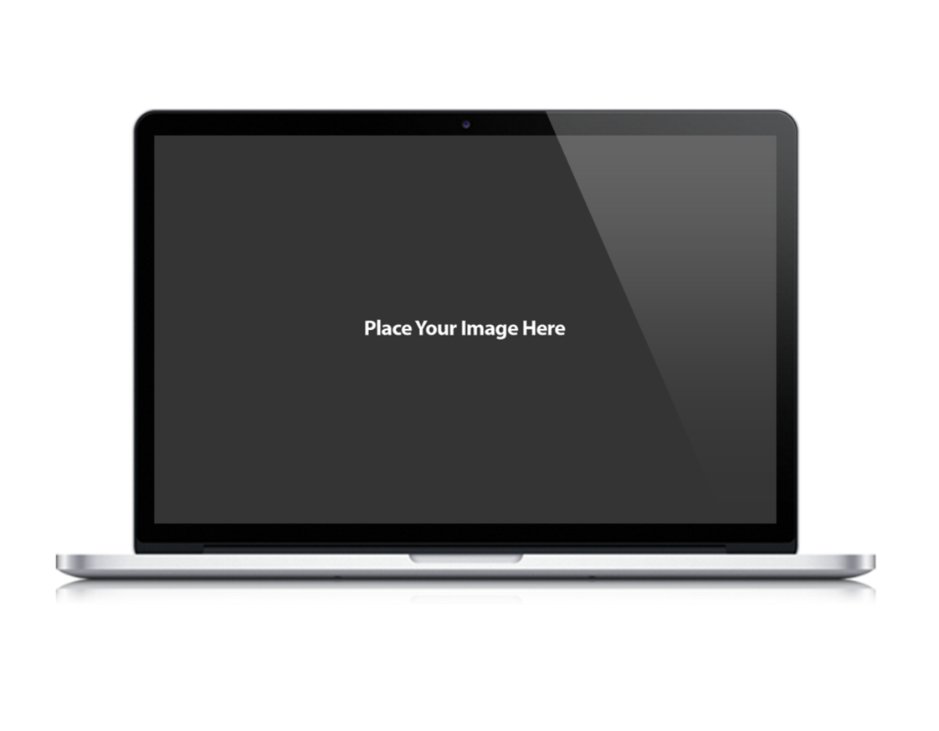
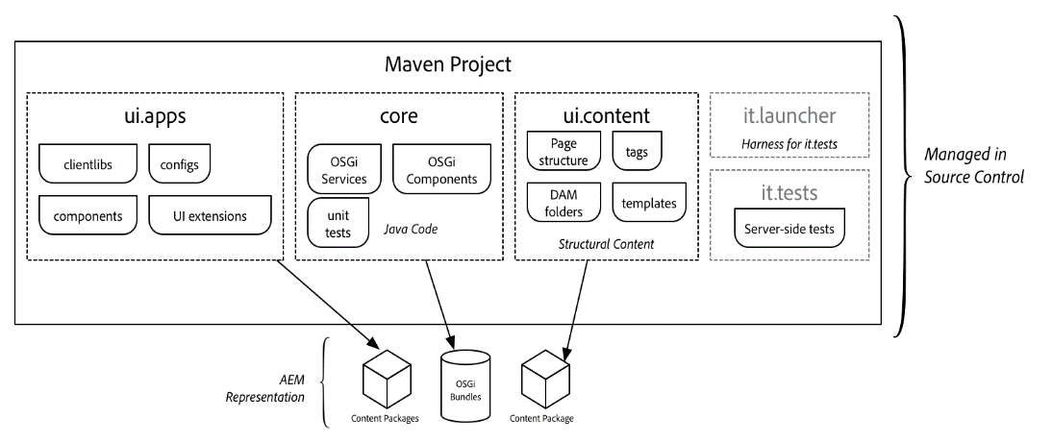
Project Structure
Parent POM - deploys maven modules and manages dependency versions
core - Java bundle containing all core functionality like OSGi services, listeners or schedulers, as well as component-related Java code such as servlets or request filters.
ui.apps - contains the /apps parts of the project, ie JS&CSS clientlibs, components, runmode specific configs as well as Hobbes-tests
ui.content - contains structural content and configurations (/content, /conf)
ui.tests - Java bundle containing JUnit tests that are executed server-side. This bundle is not to be deployed onto production.
ui.launcher - contains glue code that deploys the ui.tests bundle (and dependent bundles) to the server and triggers the remote JUnit execution

Slide 14
Build and deploy the project
Before deploy the project is recommended compile it first, using the Maven command:
mvn compile
After compile, we can build and deploy the project to the AEM author instance writing on console the following command:
mvn clean install -PautoInstallPackage
Now, you can verify on the package manager (http://localhost:4502/crx/packmgr) that your apps and content packages are installed.

Slide 15
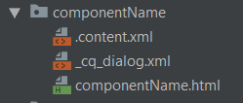
Component
Creation
Under the project folder ui.apps\src\main\content\jcr_root\apps\<Project Name>\components\content create a new folder named <Component Name>
In <Component Name> folder add the following files:
A XML file named .content.xml
A HTML file named <Component Name>.html
A XML file named _cq_dialog.xml

Slide 16
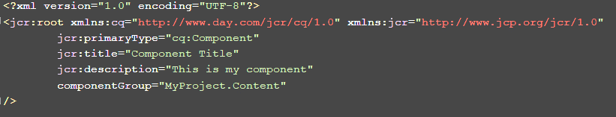
Component .content.xml
file example

Slide 17
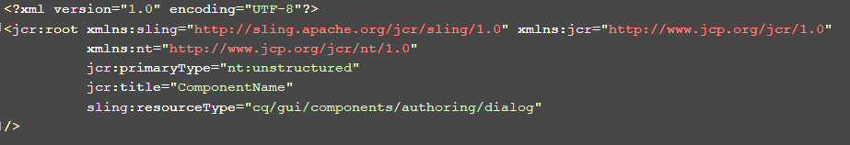
Component _cq_dialog.xml
file example

Slide 18
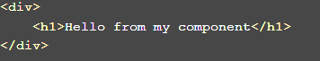
Component componentName.html
file example

Slide 19
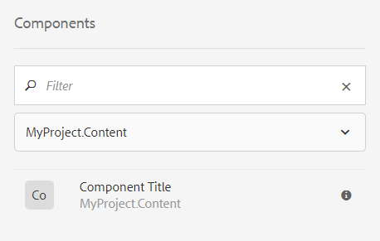
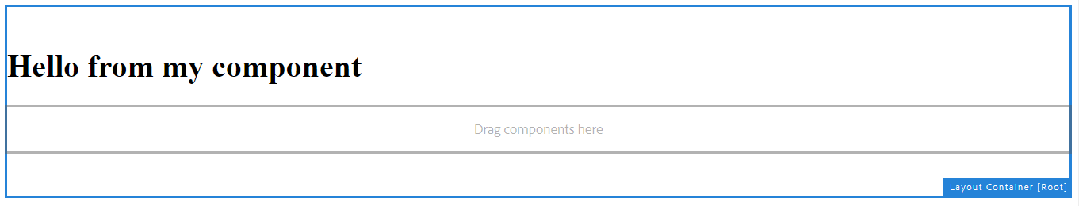
After redeploy the project, we can see the new Component in the sidekick and using it on a template

Slide 20

Thank you!

